Slide 1
Basic Sensors
ENGG 6150: Bio-Instrumentation

Slide 2
Basic Sensors
Displacement Measurement Resistive Sensors
Whetstone Bridge Circuits
Inductive Sensors
Capacitive Sensors
Piezoelectric Sensors
Temperature Measurement
Temperature Sensors
Optical Measurements
Light Sensors
Solid-State Sensors
MEMS Sensors
Sensor Calibration

Slide 3

Transducers
Transducer
a device that converts a primary form of energy into a corresponding signal with a different energy form
Primary Energy Forms: mechanical, thermal, electromagnetic, optical, chemical, etc.
take form of a sensor or an actuator
Sensor (e.g., thermometer)
a device that detects/measures a signal or stimulus
acquires information from the “real world”
Actuator (e.g., heater)
a device that generates a signal or stimulus

Slide 4
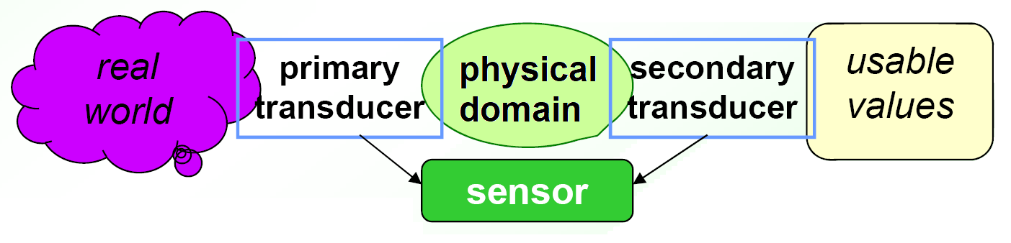
Sensor Systems
Typically we are interested in electronic sensor
Typical Electronic Sensor “System” consist of two transducers:
The primary converts the measured phenimna from one
Physical domain into another
The secondary part converts the recent physical domain into electrically measurable signal

Slide 5
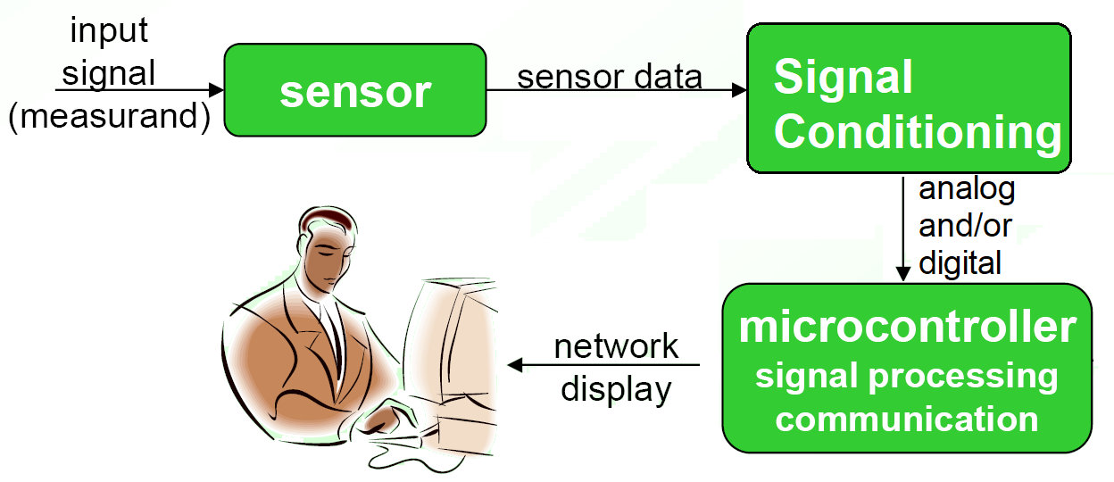
Typical Instrumentation
Sensor/sensors are the interface to the measurand
Data is obtained from the output of the sensors to be conditioned before processing
Data is stored and analyzed by personnel in control

Slide 6
Electrical Circuits Definitions and Analyses
Since the signal we are processing as an output from the sensor/transducers is an electrical signal then we need to cover the below definitions and some circuit analyses
Current and its relation to charge, i.e. integration and derivation
Ohm’s Law
Power
Energy
Passive components including wires, resistors, capacitors and inductors
Voltage and current sources

Slide 7
Basic Quantities
Electrical current:
Flow of electrons through a wire or other
electrical conductor
Electrons are negatively charged particles
- The time rate of flow of electrical charge
through a conductor or circuit element
- The units are amperes (A), which are
equivalent to coulombs per second (C/s)
- The charge per electron is -1.602×10⁻¹⁹ C

Slide 8
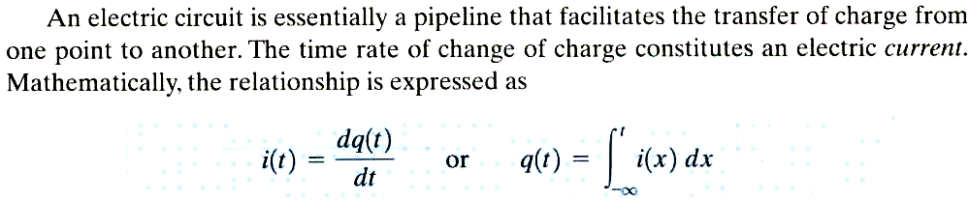
- If the charge is given determine the current by
Differentiation
- If the current is known determine the charge by
Integration
A physical analogy that helps visualize electric
Currents is that of water flow.
Charges are visualized as water particles

Slide 9
Voltage:
- The force that pushes electricity through a wire
- The voltage associated with a circuit element
is the energy transferred per unit of charge
that flows through the element. The units of
voltage are volts (V), which are equivalent to
joules per coulomb (J/C)

Slide 10
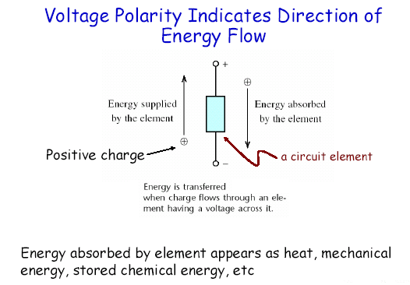

Slide 11
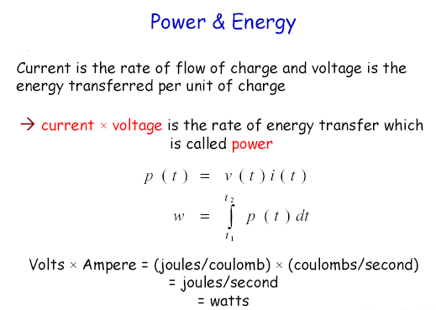

Slide 12
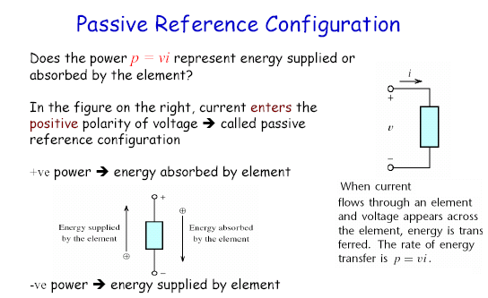
A consequence of this convention is that the reference directions for current and voltage are not independent

Slide 13
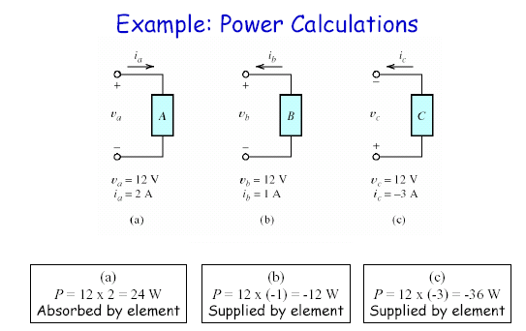

Slide 14
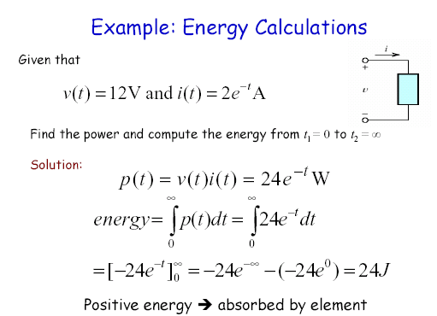

Slide 15
Example
COMPUTE POWER ABSORBED OR SUPPLIED BY EACH ELEMENT
P1 = 12W
P2 = 36W
P3 = -48W
IMPORTANT: NOTICE THE POWER BALANCE IN THE CIRCUIT

Slide 16
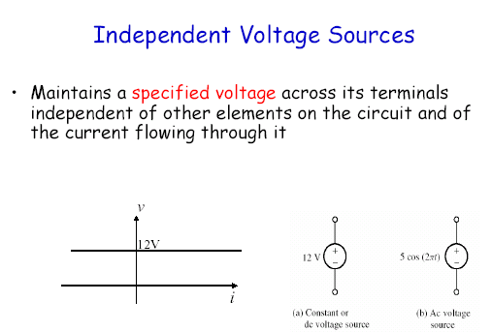

Slide 17
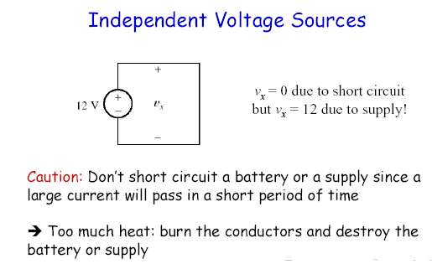

Slide 18
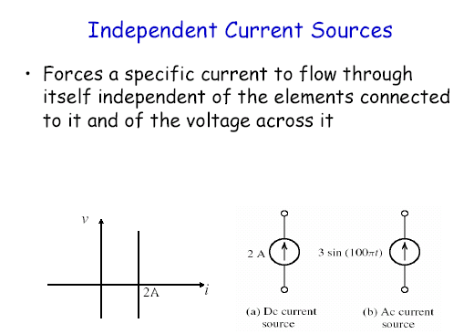

Slide 19
Why using Kirchhoff’s Laws??
When the circuit has components of resistors that are neither in series nor in parallel then Ohm’s law is not enough to find the currents and voltages.
For those complex circuits we need to use more advanced techniques such as Kirchhoff’s current and voltage laws.

Slide 20
Circuit Definitions
Wires - are assumed to have negligible resistance
Node/junction/net
Branches
Loop

Slide 21
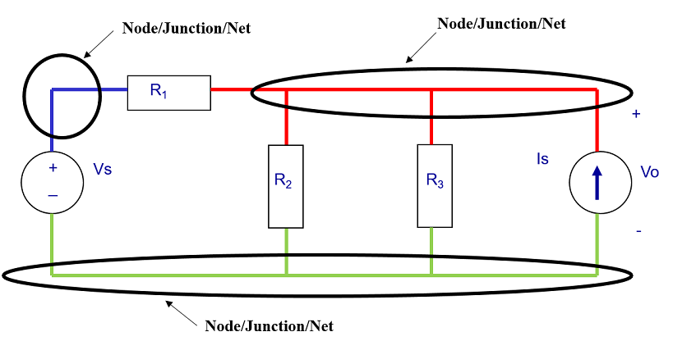
Node/Junction/Net
A node/junction/net – any point on a wire or web of wires where 2 or more circuit elements are connected together via
Each node/junction/net has one voltage (w.r.t. ground)
In the circuit shown below we have three nodes/junctions/nets

Slide 22
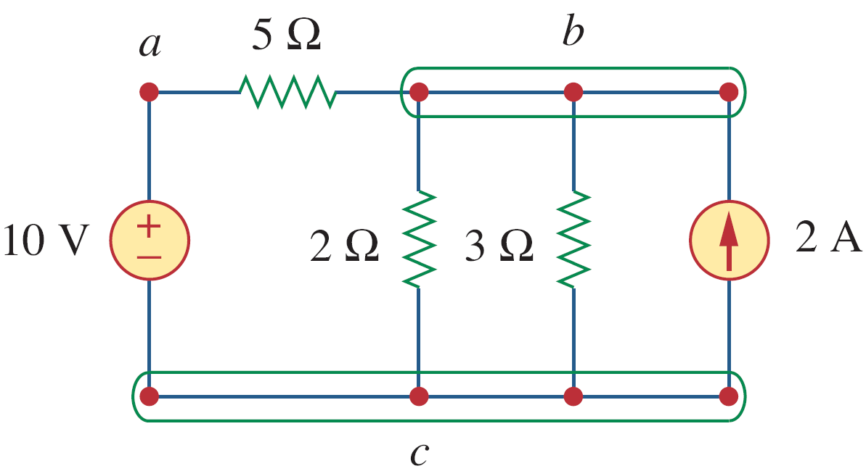
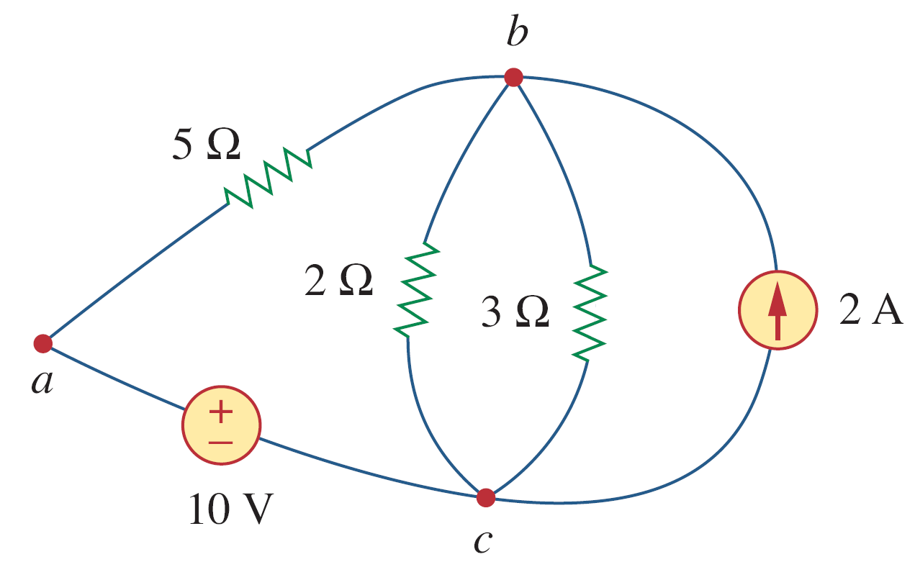
Node/Junction/Net
(a)
(b)
Circuits (a) and (b) are identical electrically, however, when it comes to drawing the circuit using dedicated schematic software then circuit (a) is the professional circuit schematic to do and use. It “looks neater”

Slide 23
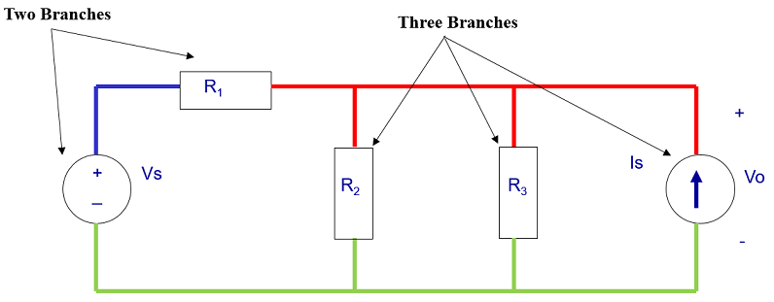
Branches
A branch – a circuit element that is between two nodes/junctions/nets
In the following circuit, there are five branches in the circuit bellow as:

Slide 24
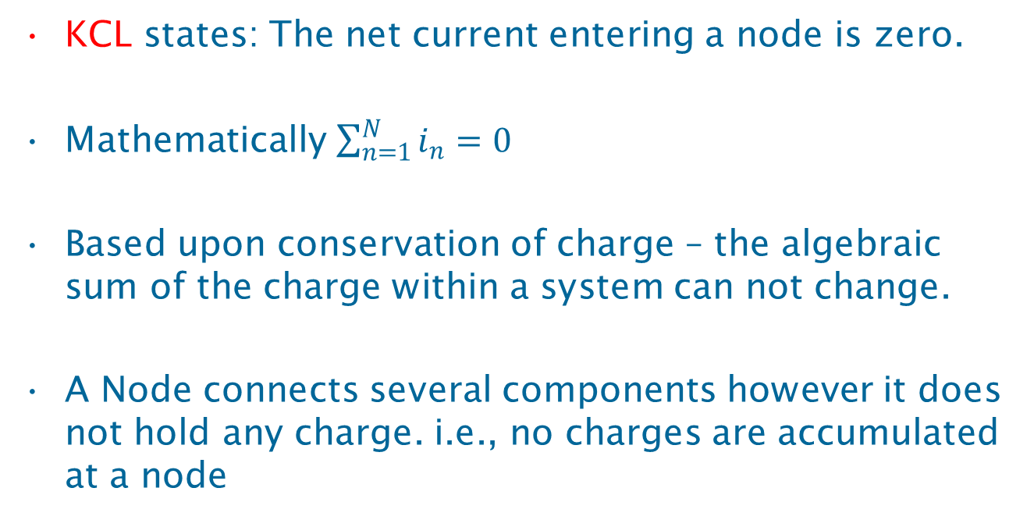
Kirchhoff’s Current Law (KCL)
KCL states: The net current entering a node is zero.
Mathematically $\sum_{n=1}^{N}{i_{n}=0}$
Based upon conservation of charge – the algebraic sum of the charge within a system can not change.
A Node connects several components however it does not hold any charge. i.e., no charges are accumulated at a node

Slide 25
Kirchhoff’s Current Law (KCL)
You can assume that
Entering currents are +ve currents
Leaving currents are -ve currents
i₁
i₃
i₂
i₃
Or
Leaving currents are +ve currents
Entering currents are -ve currents
i₄
But for the same circuit you MUST stick to ONE convention

Slide 26
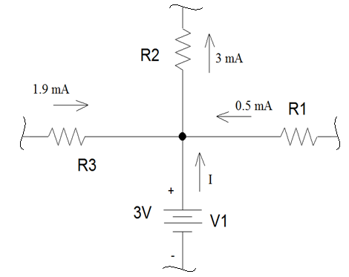
Kirchhoff’s Current Law (KCL) Example 1
Using KCL, determine I, the current flowing out of the voltage source.
Based on the assumption that states:
1- Leaving currents are +ve currents
2- Entering currents are -ve currents
We can write the following equation:
-1.9 mA - 0.5 mA + 3mA - I =0
I = 0.6 mA
Note that V1 is supplying power.

Slide 27
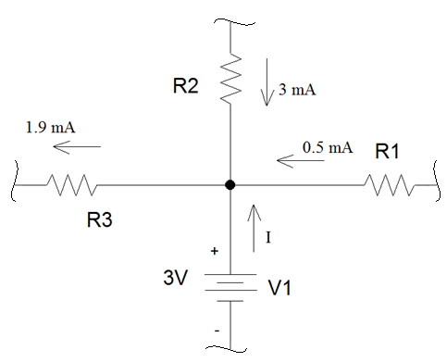
Kirchhoff’s Current Law (KCL) Example 2
Suppose the current through R2 was entering the node and the current through R3 was leaving the node.
The KCL equation using the previous assumption is:
-3 mA +1.9 mA - 0.5 mA - I =0
I = -1.6 mA
Note that V1 is absorbing power.

Slide 28
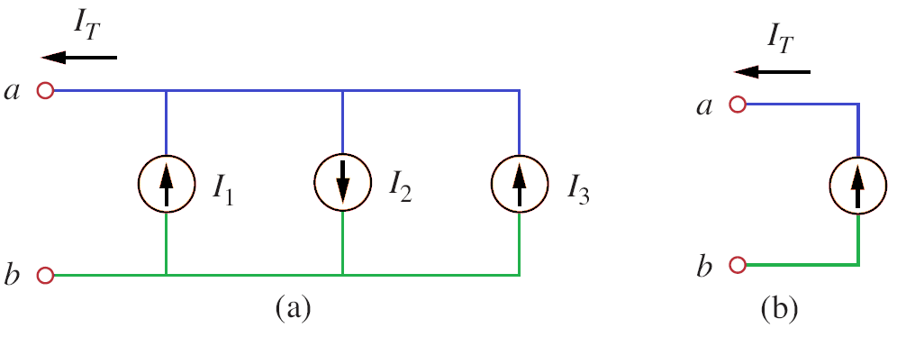
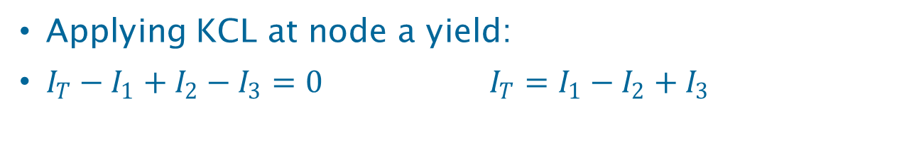
Equivalent Current Source using KCL
Applying KCL at node a yield:
$I_{T}−I_{1}+I_{2}−I_{3}=0$ $I_{T}=I_{1}−I_{2}+I_{3}$

Slide 29
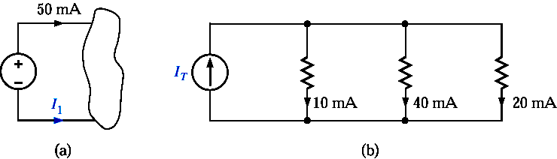
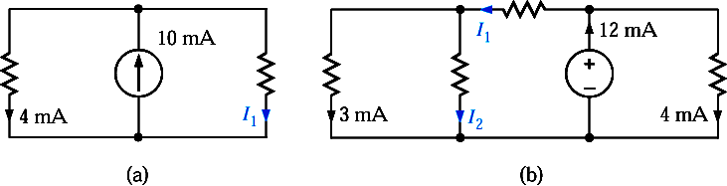
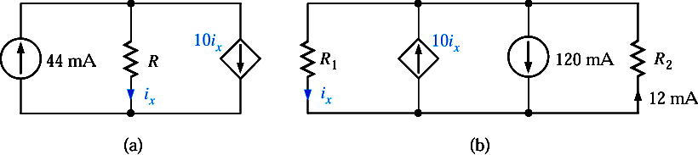
Exercises

Slide 30
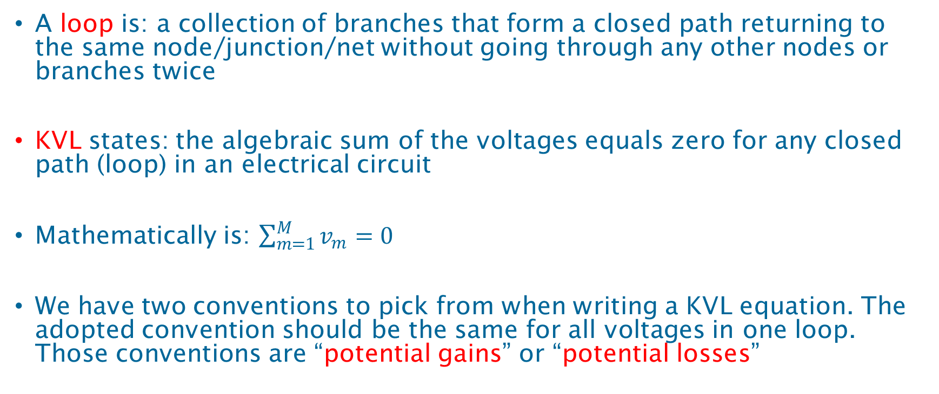
Kirchhoff’s Voltage Loop (KVL)
A loop is: a collection of branches that form a closed path returning to the same node/junction/net without going through any other nodes or branches twice
KVL states: the algebraic sum of the voltages equals zero for any closed path (loop) in an electrical circuit
Mathematically is: $\sum_{m=1}^{M}{v_{m}=0}$
We have two conventions to pick from when writing a KVL equation. The adopted convention should be the same for all voltages in one loop. Those conventions are “potential gains” or “potential losses”

Slide 31
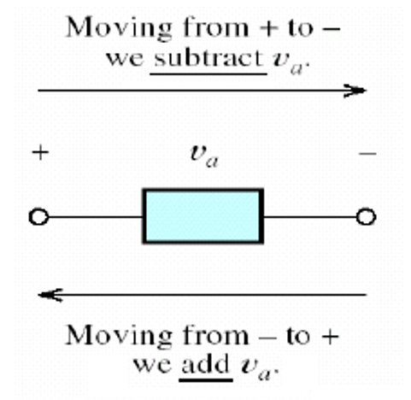
Writing KVL Equation using “Potential Gains” Convention
By using this convention, voltage drop is written as positive when moving from the negative terminal to the positive terminal of the element
In other words if the direction of the loop
agrees with the current direction
for the resistor then it is written as negative
P.S. For voltage sources if the direction of the
loop enters the negative terminal then the
voltage is written as positive

Slide 32
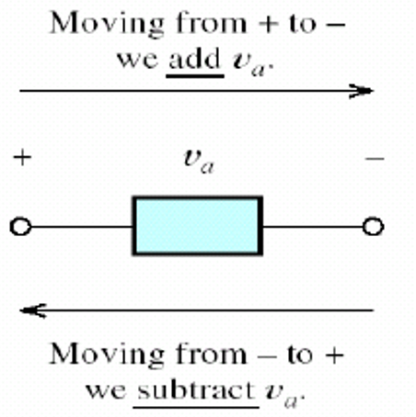
Writing KVL Equation using “Potential Losses” Convention
By using this convention, voltage drop is written as positive when moving from the positive terminal to the negative terminal of the element
In other words if the direction of the loop
agrees with the current direction
for the resistor then it is written as positive
P.S. For voltage sources if the direction of the
loop enters the negative terminal then the
voltage is written as negative

Slide 33
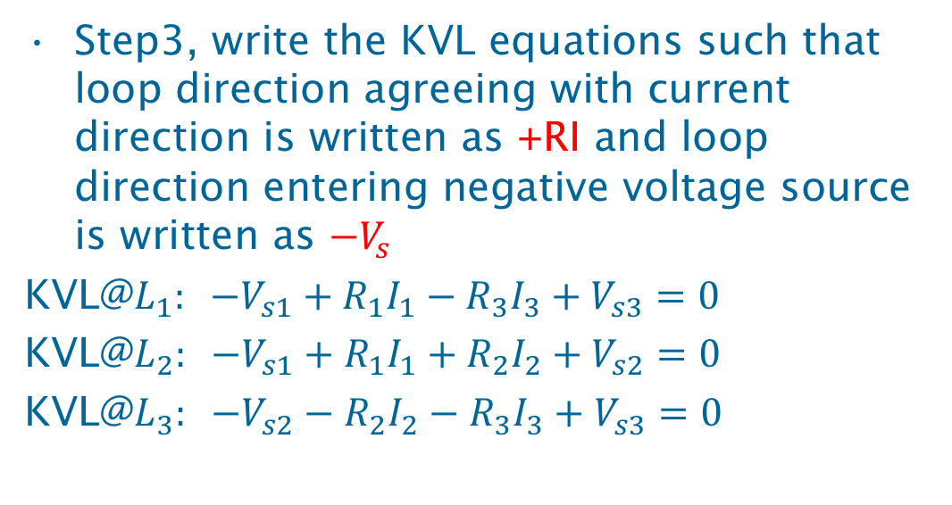
Writing KVL Equations
Write all KVL equations for the circuit below adopting one of the conventions. Using “Potential Losses” yields:
Step1, distribute currents on all branches the way you desire
A
R₁
B
I₁
Step2, draw the KVL loops the direction you desire
R₂
Vs₃
Step3, write the KVL equations such that loop direction agreeing with current direction is written as +RI and loop direction entering negative voltage source is written as ${−V}_{s}$
KVL@$L_{1}: −V_{s1}+R_{1}I_{1}−R_{3}I_{3}+V_{s3}=0$
KVL@$L_{2}: −V_{s1}+R_{1}I_{1}+R_{2}I_{2}+V_{s2}=0$
KVL@$L_{3}: −V_{s2}−R_{2}I_{2}−R_{3}I_{3}+V_{s3}=0$
E
L₁
L₂
C
L₃
Vs₁
I₃
I₂
Vs₂
R₃
D
Notes:
Potential loss as positive means that voltage is positive when it flows from positive to negative;
L1: -Vs1 + I1R1 + Vs3 –I3R3 = 0 ; L2: -Vs1 + I1R1 +I2R2+Vs2 = 0; L3: -Vs2 - I2R2 + Vs3 –I3R3 = 0
Potential gain as positive means that voltage is positive when it flows from negative to positive.

Slide 34
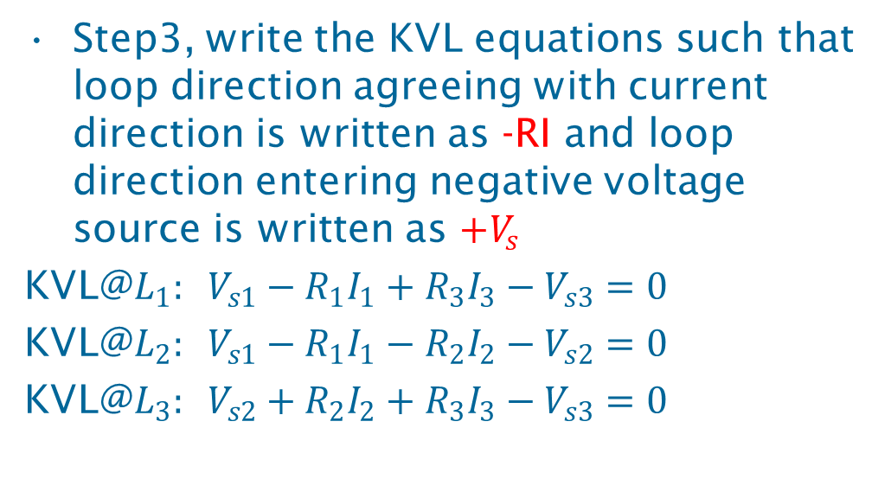
Writing KVL Equations
Write all KVL equations for the circuit below adopting one of the conventions. Using “Potential Gains” yields:
Step1, distribute currents on all branches the way you desire
A
R₁
B
I₁
Step2, draw the KVL loops the direction you desire
Vs₃
R₂
Step3, write the KVL equations such that loop direction agreeing with current direction is written as -RI and loop direction entering negative voltage source is written as ${+V}_{s}$
KVL@$L_{1}: V_{s1}−R_{1}I_{1}+R_{3}I_{3}−V_{s3}=0$
KVL@$L_{2}: V_{s1}−R_{1}I_{1}−R_{2}I_{2}−V_{s2}=0$
KVL@$L_{3}: V_{s2}+R_{2}I_{2}+R_{3}I_{3}−V_{s3}=0$
L₁
C
E
Vs₁
L₂
L₃
I₂
I₃
Vs₂
R₃
D

Slide 35
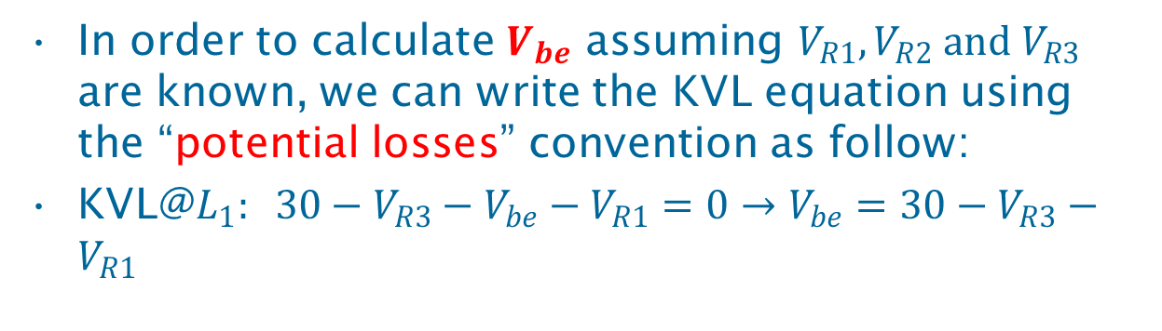


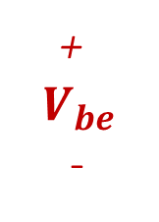
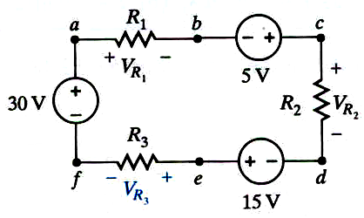
Writing KVL Equations using Double Indices Notation
The loop does not have to be a physical loop however it has to belong to the same circuit
+
$$V_{be}$$
-
The $V_{be}$ means that the potential at b is greater than the potential at e .i.e., $V_{be}$is positive.
$$L_{1}$$
In order to calculate $V_{be}$ assuming $V_{R1}, V_{R2} and V_{R3}$ are known, we can write the KVL equation using the “potential losses” convention as follow:
KVL@$L_{1}: 30−V_{R3}−V_{be}−V_{R1}=0→V_{be}=30−V_{R3}−V_{R1}$
Notes:
-VR1 + 30V –VR3 -Vbe= 0 ;

Slide 36
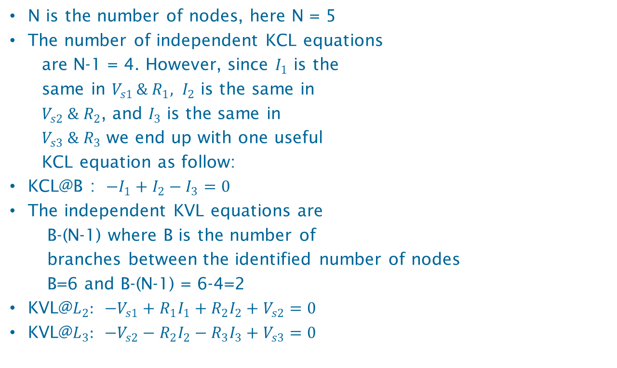
The Number of Independent KCL & KVL Equations
N is the number of nodes, here N = 5
The number of independent KCL equations
are N-1 = 4. However, since $I_{1}$ is the
same in $V_{s1 }\&{ R}_{1}, I_{2}$ is the same in
$V_{s2} \&{ R}_{2}$, and $I_{3}$ is the same in
$V_{s3} \&{ R}_{3}$ we end up with one useful
KCL equation as follow:
KCL@B : ${−I}_{1}+I_{2}−I_{3}=0$
The independent KVL equations are
B-(N-1) where B is the number of
branches between the identified number of nodes
B=6 and B-(N-1) = 6-4=2
KVL@$L_{2}: −V_{s1}+R_{1}I_{1}+R_{2}I_{2}+V_{s2}=0$
KVL@$L_{3}: −V_{s2}−R_{2}I_{2}−R_{3}I_{3}+V_{s3}=0$
A
R₁
B
I₁
R₂
Vs₃
L₁
C
E
Vs₁
L₂
L₃
I₂
I₃
Vs₂
R₃
D
Using “Potential Losses” convention

Slide 37


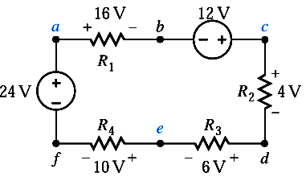


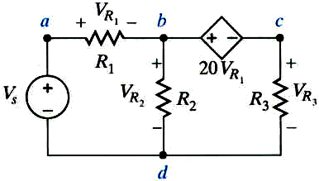

KVL Examples
Dependent Sources are handled with the same ease

Slide 38
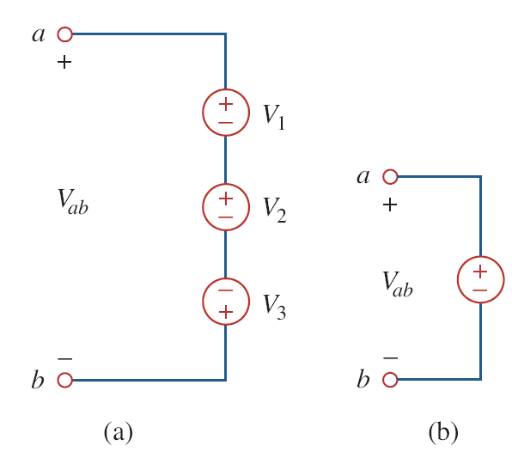

Equivalent Voltage Source using KVL
Applying KVL on circuit (a) using
“Potential Losses” convention yields:
$V_{1}+V_{2}−V_{3}−V_{ab}=0$
$V_{ab}=V_{1}+V_{2}−V_{3}$
Note: To avoid violating KVL, a
circuit can not contain two parallel
voltage sources that are not equal

Slide 39
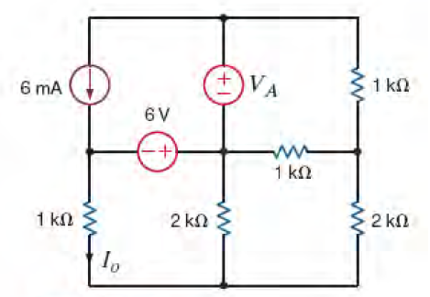





















All Rules in one Example
P.S. 1- Potential Losses for KVL, and 2- entering currents are negative for KCL are adopted here.
Given $I_{o}=2mA, u$sing KVL and KCL find $V_{A}$, solution is:
Identify distinguished nodes
a
Assign arbitrary currents
$$I_{4}$$
$$I_{5}$$
Using Ohm’s law $V_{o}=1kΩ∗2mA=2V$
+
$$V_{5}$$
-
$$L_{3}$$
KVL@$L_{1}:−2−6+V_{2}=0→V_{2}=8V$
$$I_{1}$$
c
+ $V_{3}$ -
$$I_{3}$$
$I_{2}=\frac{8}{2kΩ}=4mA$
b
d
+
$$V_{o}$$
-
$\text{KCL}\text{@}\text{e}\text{: }−I_{o}−I_{2}−I_{6}=0→$
+
$$V_{2}$$
-
+
$$V_{6}$$
-
$I_{6}=−6mA →V_{6}=−6mA∗2kΩ=−12V$
$$L_{1}$$
$$L_{2}$$
$\text{KVL}\text{@}L_{2}:−8−12+V_{3}=0→V_{3}=20V$
$$I_{2}$$
$$I_{6}$$
$I_{3}=\frac{20}{1kΩ}=20mA$
e
$\text{KCL}\text{@}\text{d}\text{: }−I_{5}−I_{3}+I_{6}=0→I_{5}=−20−6=−26mA →$
$V_{5}=−26mA∗1kΩ=−26V$
$\text{KVL}\text{@}L_{3}:−26−20−V_{A}=0→V_{A}=−46V$

Slide 40
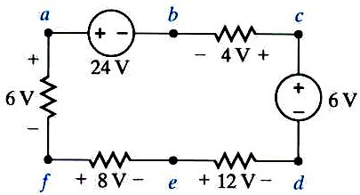
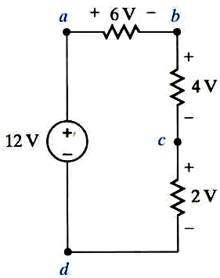
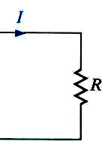
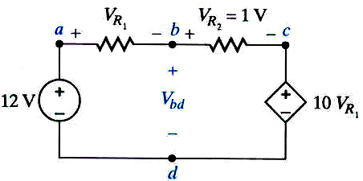
Exercises
(a)
(b)
(c)
(d)

Slide 41
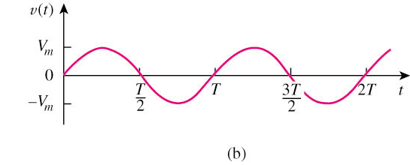
Sinusoids
A sinusoid is a signal that has the form of the sine or cosine function.
A general expression for the sinusoid,
where
Vm = the amplitude (peak) of the sinusoid
ω = the angular frequency in radians/s
Ф = the phase
T = Period

Slide 42
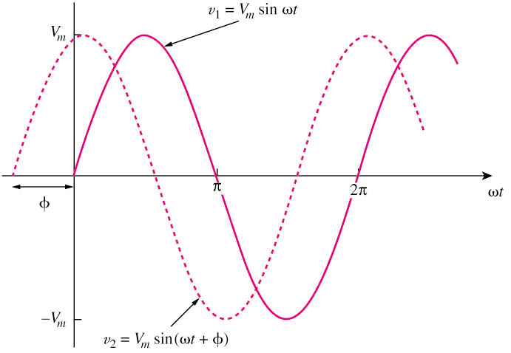
Sinusoids
A periodic function is one that satisfies v(t) = v(t + nT), for all t and for all integers n where T is the period.
Only two sinusoidal values with the same frequency can be compared by their amplitude and phase difference.
If phase difference is zero, they are in phase; if phase difference is not zero, they are out of phase.

Slide 43
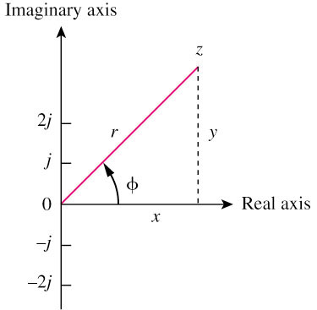
Phasors
A phasor is a complex number that represents the amplitude and phase of a sinusoid.
It can be represented in one of the following forms:
Rectangular
Polar
where

Slide 44
Phasors
Transform a sinusoid to and from the time domain to the phasor domain:
(time domain) (phasor domain)
Amplitude and phase difference are two principal concerns in the study of voltage and current sinusoids.
Phasor will be defined from the cosine function in all our proceeding study. If a voltage or current expression is in the form of a sine, it will be changed to a cosine by subtracting from the phase.

Slide 45
Complex Numbers
To add or subtract two numbers you must convert them to rectangular first and then do the operation
To multiply two complex numbers in polar form
To divide two complex numbers in polar form

Slide 46


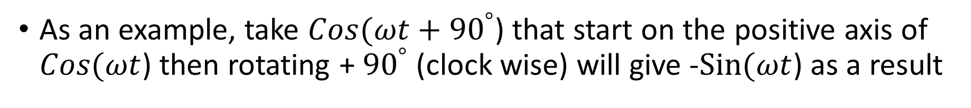
Trigonometric Identities
Sin($ωt)$
-
Cos($ωt)$
As an example, take $Cos(ωt+{90}^{°}$) that start on the positive axis of $Cos(ωt$) then rotating + ${90}^{°}$ (clock wise) will give -$Sin(ωt$) as a result

Slide 47
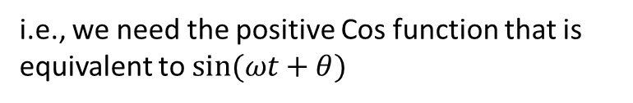
COMPLEX IMPEDANCES: Inductances
i.e., we need the positive Cos function that is equivalent to $sin⁡(ωt+θ)$
Current through the inductor lags the voltage by 90º
Z_{L} = jwL is called the impedance of
the inductance (measured in ohms)
Ohm’s law in phasor form

Slide 48
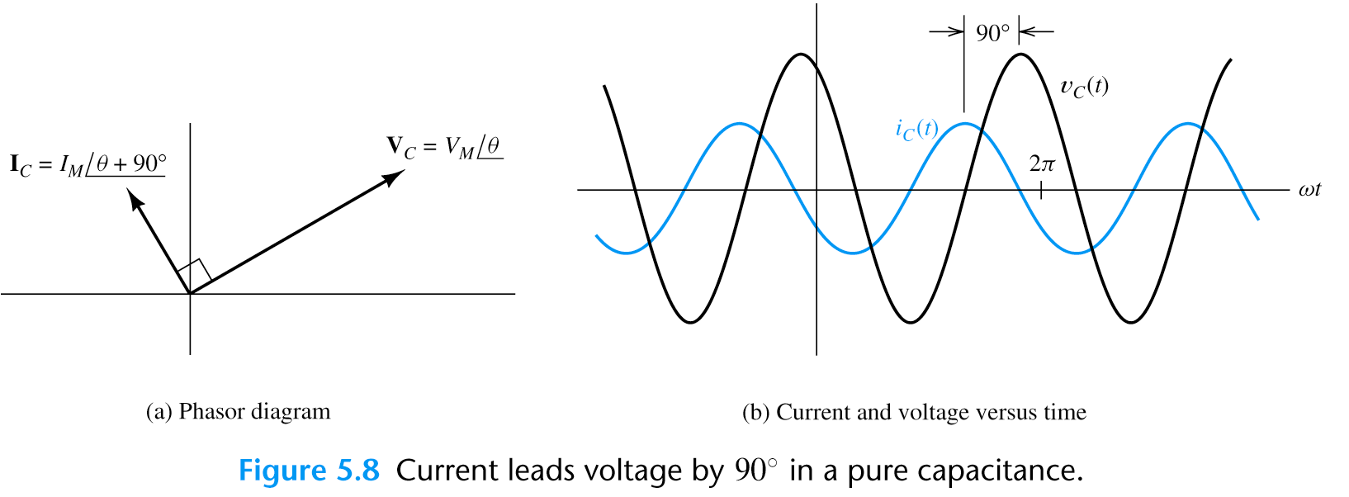
COMPLEX IMPEDANCES: Capacitance
Current through the capacitor leads the voltage by 90º

Slide 49
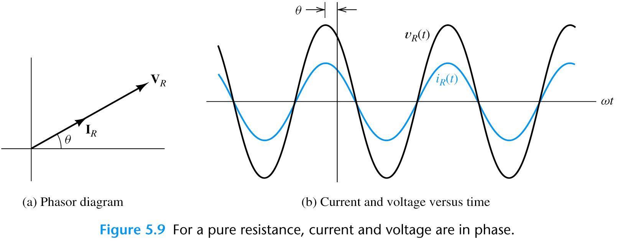
COMPLEX IMPEDANCES: Resistance

Slide 50
Phasor Relationships for Circuit Elements
Summary of voltage-current relationship
Element | Time domain | Frequency domain
R
L
C

Slide 51
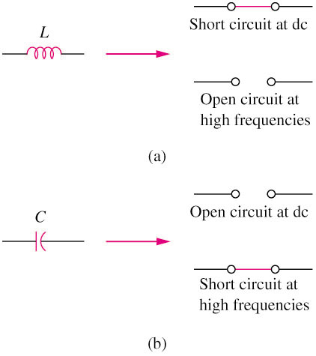
Impedance and Admittance

Slide 52
Circuit Analysis Using Phasors and Impedances
1. Replace the time descriptions of the voltage and current sources with the corresponding phasors. (All of the sources must have the same frequency.)

Slide 53
2. Replace inductances by their complex
impedances Z_{L} = jωL. Replace
capacitances by their complex impedances Z_{C} = 1/(jωC). Resistances have impedances equal to their resistances.
3. Analyze the circuit using any of the techniques studied earlier for DC circuits, performing the calculations with complex arithmetic.

Slide 54
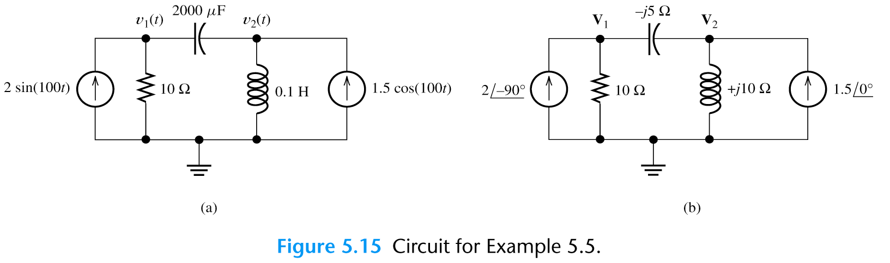
Example 7: Use nodal analysis to find v₁(t) in steady state.
Solving (1a) and (2a)

